Slide 1
If a business is linked to a COVID case
July 2021

Slide 2
Contents
This pack will help businesses who have been linked to a COVID-19 case communicate with their customers. It includes content and links to download additional materials.
Summary of action steps
Communicating to staff and customers
Example email/letter copy to send to customers on closure and re-opening
Social media tiles for your channels
Poster
Additional messaging for impacted businesses
Implementing infection control
Information on infection control

Slide 3
Summary of action steps
The reality of having businesses open during the COVID-19 pandemic means there will be occasions where someone enters a venue who is later diagnosed with COVID-19. In this situation there is a process in place to manage the risk of the virus spreading, and ensure the business is back open and operating as quickly as possible.
Once notified of a link, the local Public Health Unit will advise of next steps and the necessary measures to take before the business can safely reopen.
Keeping business open during the pandemic means we must remain vigilant. All businesses are strongly encouraged to complete a COVID-19 Safety Plan and register as a COVID Safe business to ensure they’re meeting all the requirements, for some this is mandatory. It will also let customers and staff know their health is a priority.
To contact your local Public Health Unit, call 1300 066 055.
For more information, visit guidance for businesses with linked COVID-19 cases
To complete a COVID-19 Safety Plan, register as a COVID Safe business and get a NSW Government QR code, visit the COVID Safe businesses page on the NSW Government website.

Slide 4
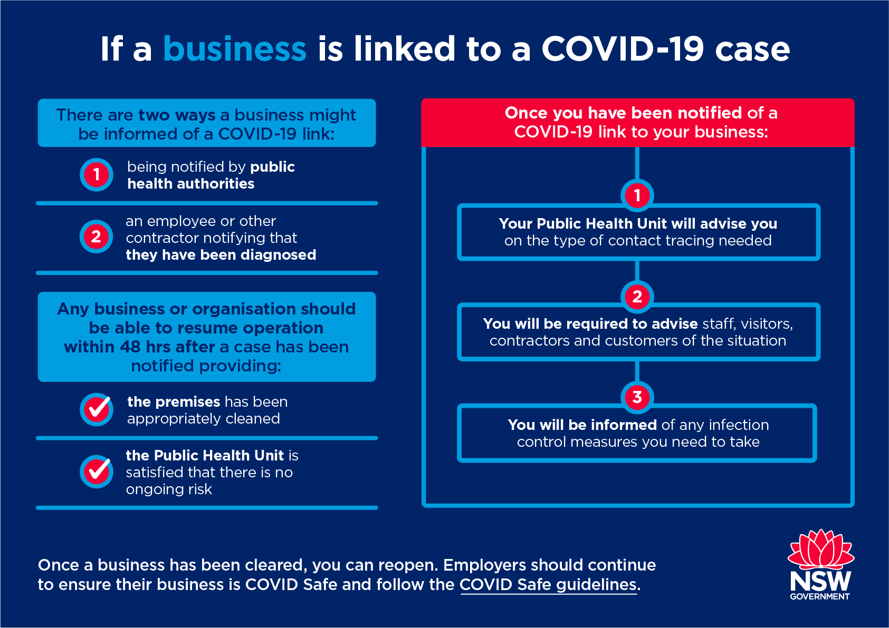
Summary of action steps
Find the COVID Safe guidelines for businesses with linked COVID-19 cases.
Click here to download a high res version of the image.

Slide 5
Communicating to staff and customers
If a case of COVID-19 is linked to your business, a critical part of containing the spread of the virus is making staff, visitors, contractors and customers aware of the situation.
You can do this in a range of ways, including via posters, letters or other channels.
Once your business has been cleared to open you may want to again notify customers that your doors are open and reassure them that you have all the appropriate measures in place.
The following content has been designed to help you communicate quickly and easily.

Slide 6
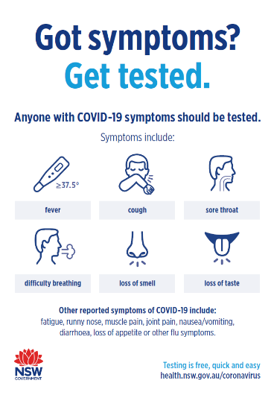
Example email/letter copy to send to customers on closure
Temporary closure due to COVID-19 case
On [date] someone visited our premises who has since tested positive for COVID-19. This means there is a chance that customers who visited our premises on [date] could have been exposed to the virus.
We are working with NSW Health to help identify those customers and staff who may be at risk. If you are considered at risk and need to self isolate the local Public Health Unit will contact you with advice.
We are doing all we can to ensure our premises are safe for our customers and staff.
We know this is a part of running a business during a pandemic. While we’re sad to close our doors it is the right thing to do. We are working with the public health authorities and Safe Work NSW to conduct the infection control measures required so we can open our doors again.
We thank our customers, our team and our community for your ongoing support.
Your safety and the safety of our staff will remain our number one priority.
We will be back open again soon.
Link to download
Links to translations

Slide 7
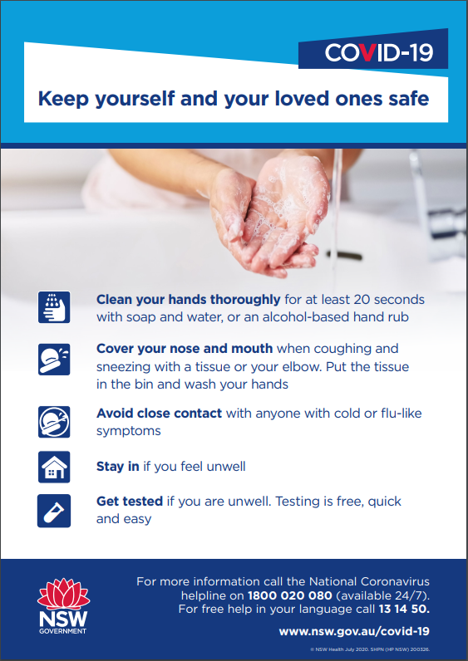
Example email/letter copy to send to customers on re-opening
Back in business
We are happy to be back open from [date] and back to serving our community. We have followed all the NSW Health guidance to ensure we can safely reopen, and we assure you that we continue to be vigilant.
[For businesses with a COVID Safe plan] Our COVID Safe plan remains in place and your safety continues to be our priority.
But we can’t do this alone. We’re asking all our customers to support the measures we have in place – these include:
[e.g. hand sanitiser]
[e.g. regular cleaning of all surfaces]
[e.g. single use napkins/menus]
[e.g. staff wear masks]
…
Help us keep our community safe and help NSW stay in business.
A sincere thank you to our customers, our team and our community for your ongoing support, and we can’t wait to have you back here soon.
Link to download

Slide 8
Social media tiles for your channels: re-opened
To download, right click on tile and select ‘Save as picture’ or click the link above each image for a higher resolution version
Click here to download a hi-res image
Click here to download a hi-res image
Click here to download a hi-res image
Post: We are happy to be back open and serving our community. Your safety is our priority, but we can’t do it alone. The best thing you can do is be a COVID Safe customer. Follow the rules, be patient. Together, we can make a difference.
Post: The safety of our customers and staff is our number one priority. But we need your help. Support the measures we have in place. Stay home if you feel unwell or if you are waiting for COVID test results.
Post: We’re open again. Our COVID Safe plan remains in place and your safety is our priority. Help us keep our community safe and our doors open.

Slide 9
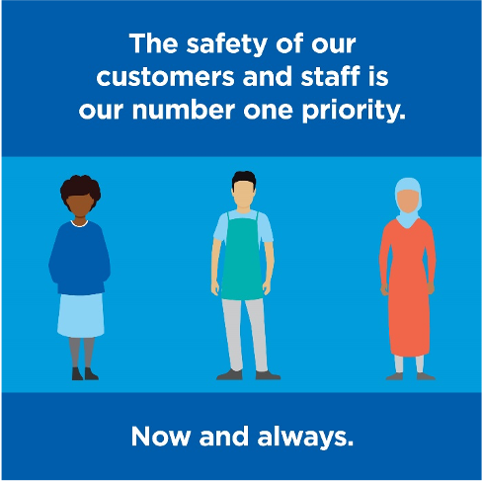
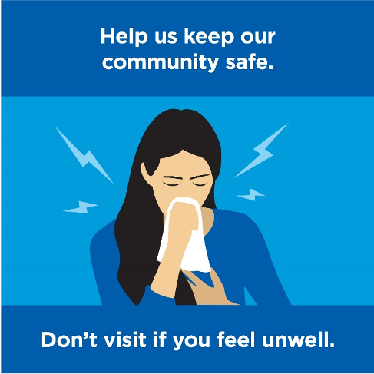
Social media tiles for your channels (non-branded)
To download, right click on tile and select ‘Save as picture’ or click the link above each image for a higher resolution version
Click here to download a hi-res image
Click here to download a hi-res image
Click here to download a hi-res image
Post: We’re excited to be back open and serving our community. Pay us a visit and see the measures we have in place to keep you safe.
Post: We know this is part of running a business during a pandemic. Our doors are back open and we’re doing all we can to keep our customers and staff safe.
Post: Simple things can make a difference and help keep businesses like ours open. Wash your hands thoroughly, if you feel unwell stay in and get tested. We can all play a role.

Slide 10
Additional messaging for impacted businesses
These example key messages explain what has caused your business to close, how you are keeping people safe and why customers should feel comfortable to return when you reopen. Include the three elements in each communication where possible​.
What caused your business to close
As we’ve continued to operate during this pandemic, we have done all we can to ensure our premises are safe for our customers and staff
Unfortunately [on date] someone visited our premises who has since tested positive for COVID-19
This means there is a chance that customers who visited our premises on [date] could have been exposed to the virus
How you are ensuring your customers and staff are safe
We know this is a part of operating our business during a pandemic and we will always do the right thing
We are working with NSW Health to help identify those customers and staff who may be at risk
We’ve closed our doors and are working with public health authorities and Safe Work NSW to conduct the infection control measures required and ensure we do everything we need to open our doors again
We thank our customers, our team and our community for their support
[for registered COVID Safe businesses] We are a registered COVID Safe business and are committed to protecting the community and preventing the spread of COVID-19
Why customers can now return as you have reopened safely
We have opened our doors again
We’ve implemented [state what you’re doing now to keep people safe]
Our safety measures remain in place and we continue to be vigilant
[for registered COVID Safe businesses and/or have a COVID Safe Plan in place] Our COVID Safe plan remains in place so please support us in staying COVID Safe
We can’t do this alone. We need all our customers to do the right thing.
The safety of our customers and staff is our number one priority
Help us keep our community safe and help NSW stay in business

Slide 11
Implementing infection control
If a case of COVID-19 is linked to your business you will be directed by public health authorities to implement certain infection control measures.
This might include cleaning and disinfection or ensuring all staff are tested for COVID-19, regardless of if they’re showing symptoms.
The following is an overview and links to the full details on what is involved.

Slide 12
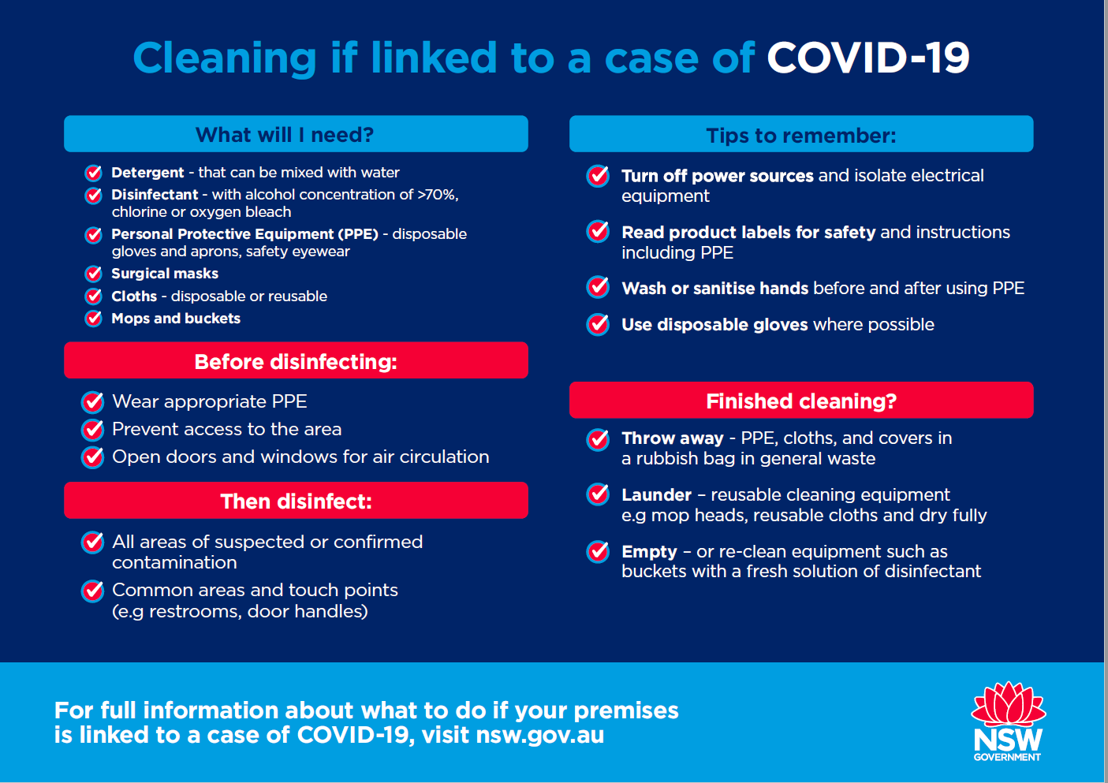
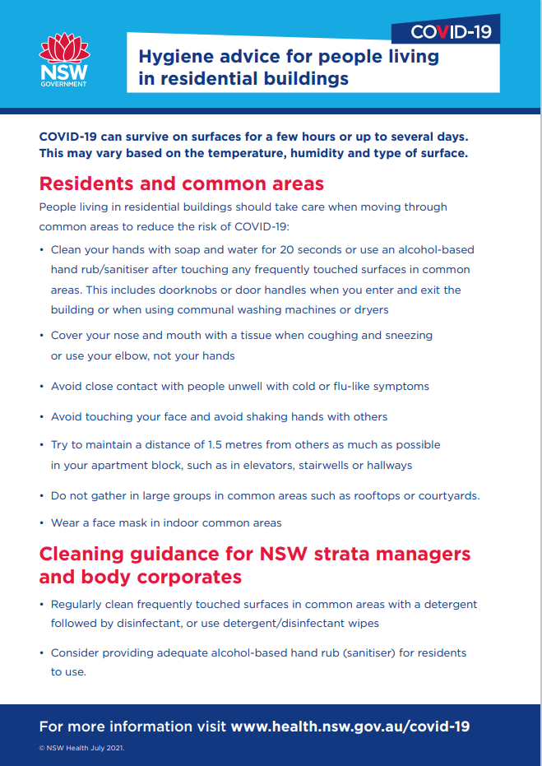
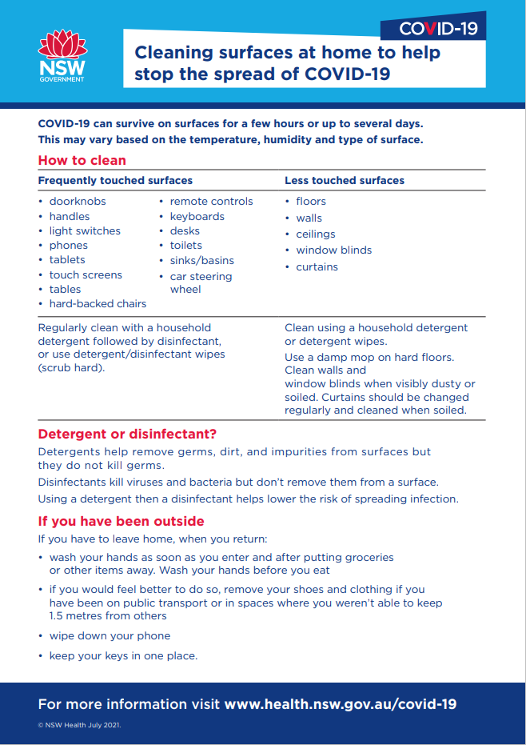
Update: hygiene and cleaning
To download, click the link above each image
Click here to download
Click here to download
Click here to download

Slide 13
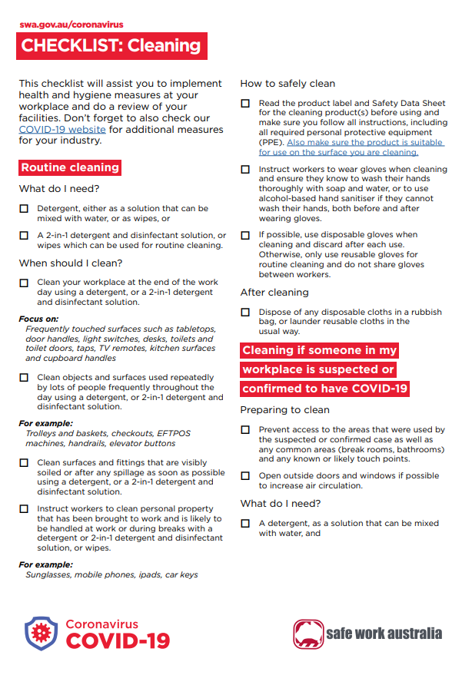
Information on infection control
More information:
See SafeWork Australia for a checklist on what cleaning products you will need, and what surfaces you should clean.
For step-by-step guidance on cleaning and disinfection following a case or suspected case of COVID-19, download the cleaning toolkit.
For more information on how to clean if someone in your workplace is suspected or confirmed to have COVID-19, go to the SafeWork Australia cleaning FAQs

